Slide 1

Customer Shopping Behavior Analysis
Uncovering insights from 3,900 purchases to guide strategic business decisions

Slide 2
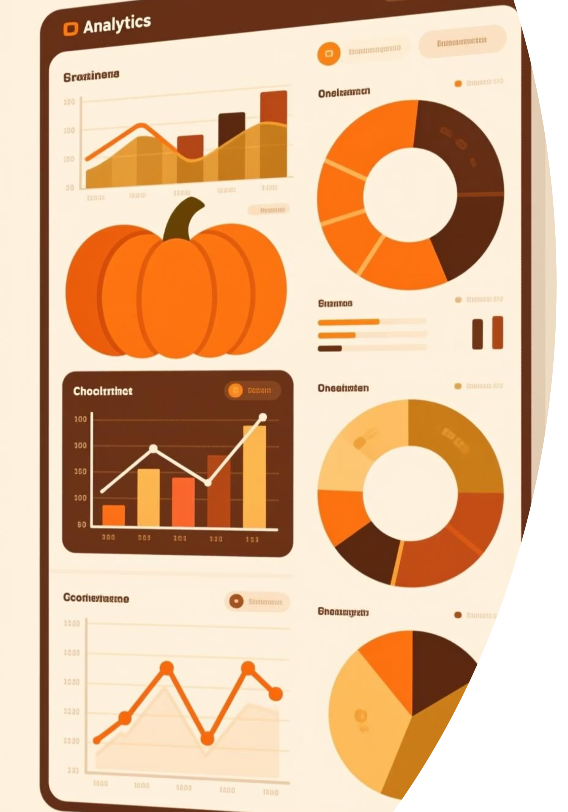
Dataset at a Glance
3,900
18
50
Total Purchases
Data Points
Locations
Transactions analyzed
Features per purchase
Geographic spread
25
Products
Items tracked

Slide 3
Data Preparation Journey
01
02
03
Data Loading
Exploration
Cleaning
Imported dataset using pandas
Summary statistics and structure analysis
Imputed 37 missing review ratings by category median
04
05
Feature Engineering
Database Integration
Created age groups and purchase frequency metrics
Loaded cleaned data into PostgreSQL

Slide 4
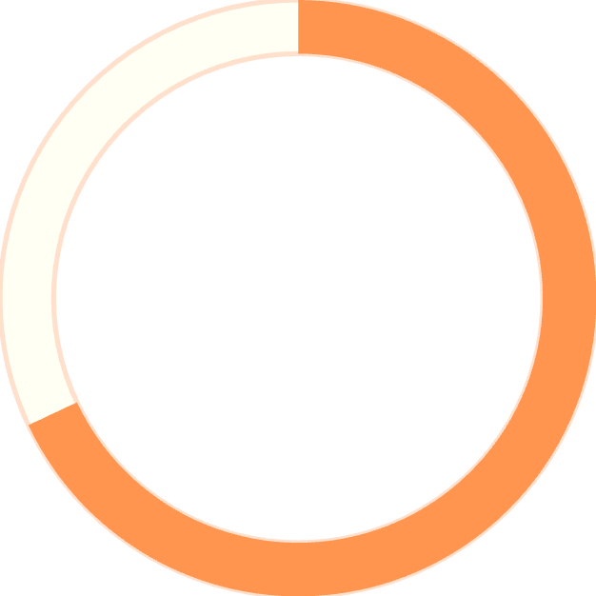
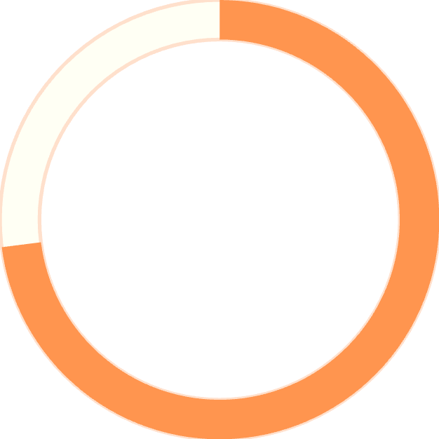
Key Customer Metrics
Customer Demographics
Age range: 18-70 years
Median age: 44 years
68%
50 unique locations
4 product categories
Male Customers
73%
Non-Subscribers

Slide 5
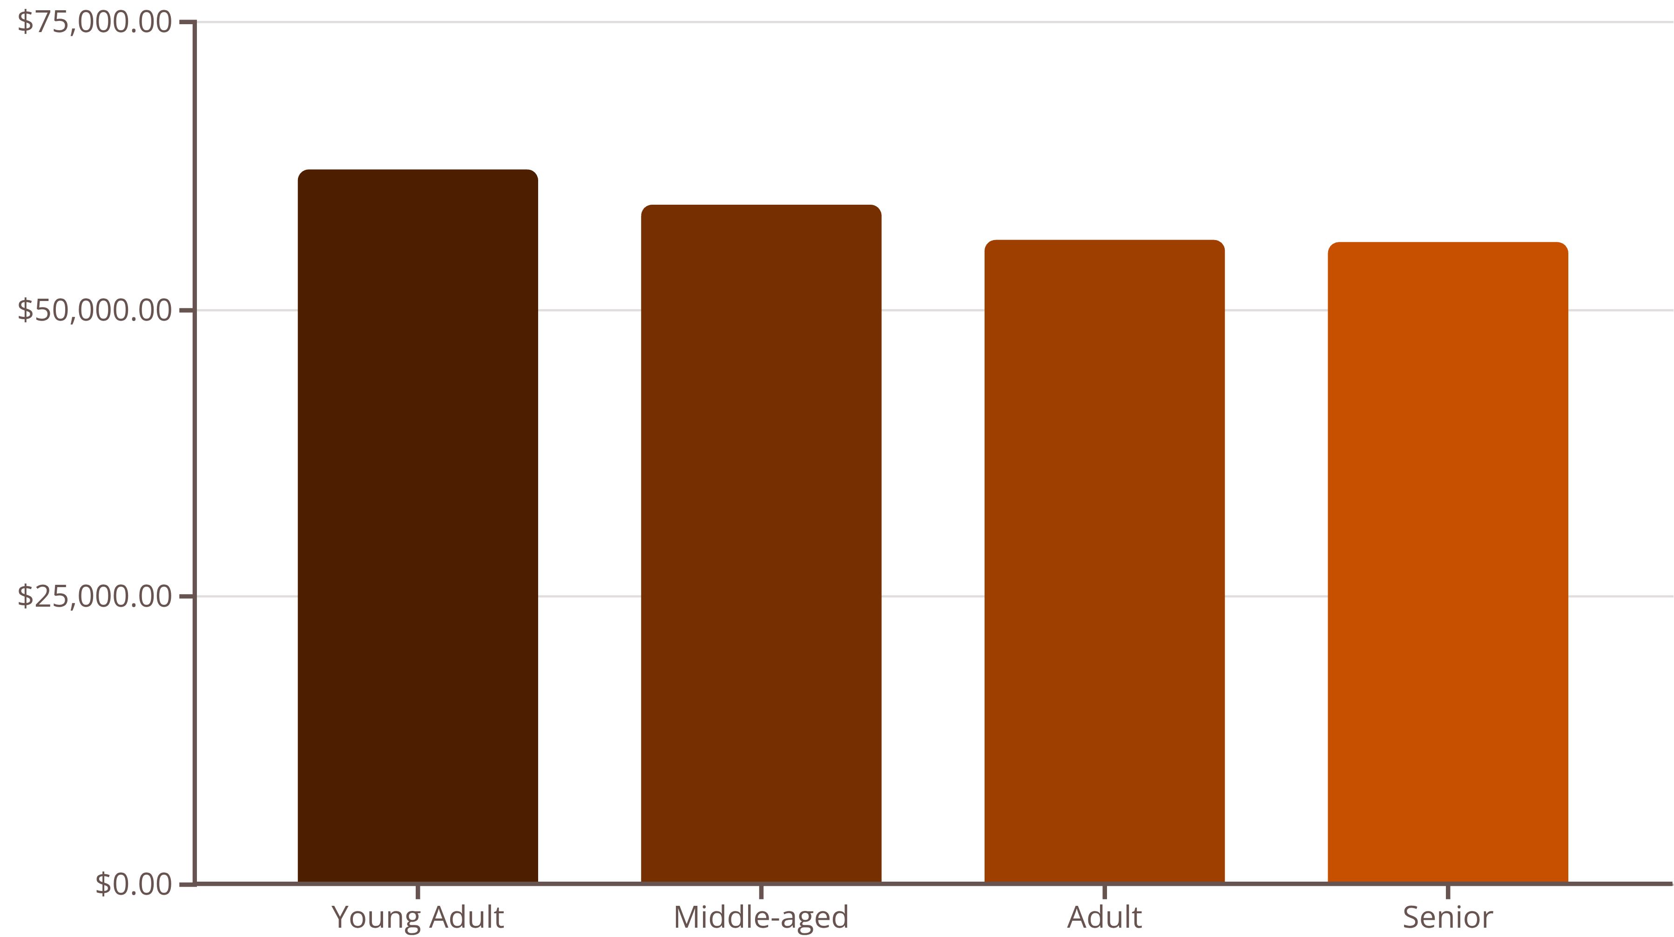
Revenue Insights
Male Revenue
Female Revenue
Average Purchase
$157,890
$75,191
$59.76
68% of total revenue
32% of total revenue
Per transaction

Slide 6



Customer Segmentation
New
1
83 customers
Returning
2
701 customers
Loyal
3
3,116 customers
80% of customers classified as Loyal based on purchase history

Slide 7
Product Performance
Top 5 Products by Rating
Category Leaders
77%
77%
Clothing: Blouse (171 orders)
Accessories: Jewelry (171 orders)
Gloves
Sandals
Footwear: Sandals (160 orders)
Outerwear: Jacket (163 orders)
3.86 rating
3.84 rating
76%
76%
Boots
Hat
3.82 rating
3.80 rating
76%
Skirt
3.78 rating

Slide 8

Discount & Shipping Behavior
Smart Spenders
Express Premium
839 customers used discounts but spent above average ($59.76)
Express shipping: $60.48 avg
Standard shipping: $58.46 avg
Discount Leaders
Hat (50%), Sneakers (49.7%), Coat (49.1%)

Slide 9
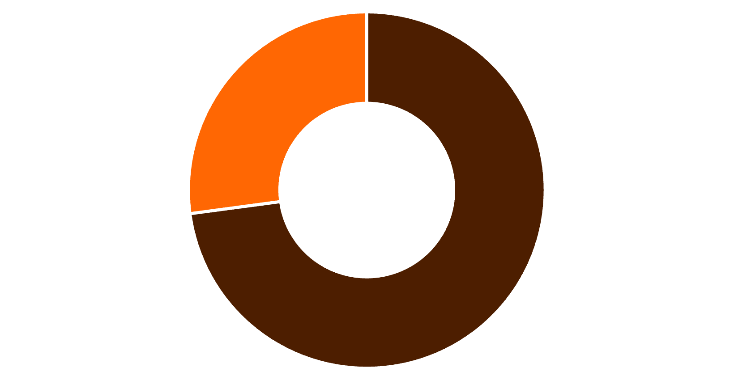
Subscription Analysis
Subscription Insights
27% subscription rate
Subscribers: $59.49 avg spend
Non-subscribers: $59.87 avg spend
958 repeat buyers (>5 purchases) are subscribers
Non-Subscribers
Subscribers

Slide 10

Strategic Recommendations
Boost Subscriptions
Loyalty Programs
Review Discounts
Promote exclusive benefits to convert 73% non-subscribers
Reward repeat buyers to strengthen 3,116 loyal customers
Balance sales boosts with margin control on high-discount items
Targeted Marketing
Product Positioning
Focus on young adults and express-shipping users for maximum ROI
Highlight top-rated products (Gloves, Sandals, Boots) in campaigns

